Slide 1
WELCOME
A SOLUTION FOR COMPLETELY AUTONOMOUS DRONE WITHOUT GPS & VARIOUS MISSION CAPABILITIES

Slide 2
Phases of project :
Phase 1 : To build an autonomous drone that follows a flight plan.
Phase 2 : To remove GPS and make Completely autonomous drone that follow flight plan. Phase 3 : To add obstacle avoidance and path verification update for long range drift errors. Phase 4 : Adding drop mechanism to drop a payload. Phase 5 : Adding person/drone tracking. Phase 6 : Refining errors, increasing speed, changing type of drone.

Slide 3
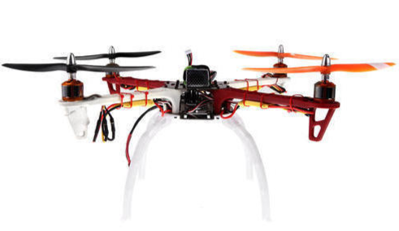
1) Making a DIY drone with Pixhwak Flight Controller.
2) Flying a normal drone to remove calibration error to avoid disbalance.

Slide 4
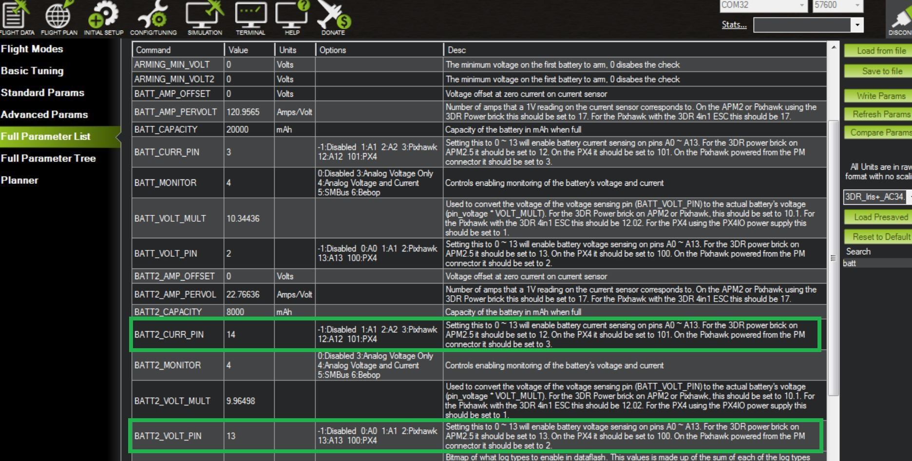
3) Connecting Drone with raspberry pi using Mavlink
4) Modifying Pixhawk parameters to take commands from Raspberry Pi and not from RF.

Slide 5
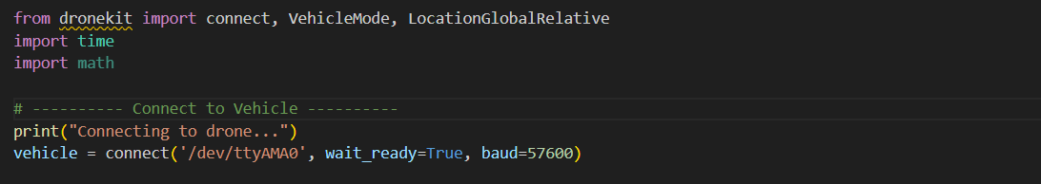
4) Testing Mavlink commands to arm and disarm drone.
5) Writing a python script using dronekit python library.
Example Script used while test flight :

Slide 6
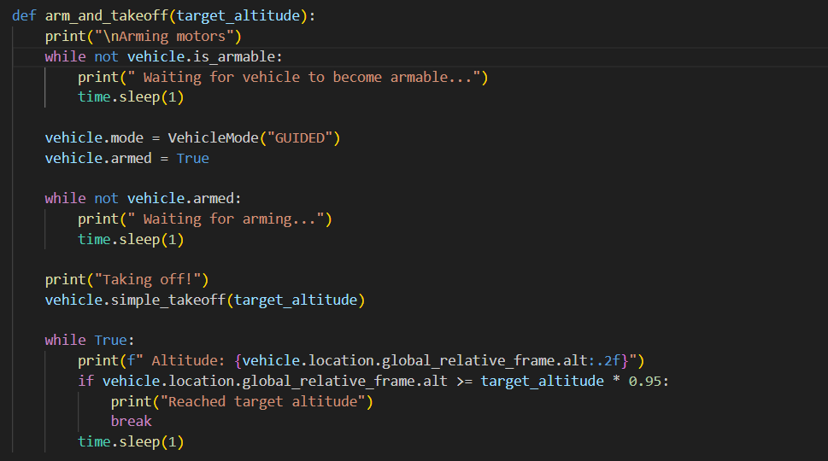
Example Script used while test flight :

Slide 7
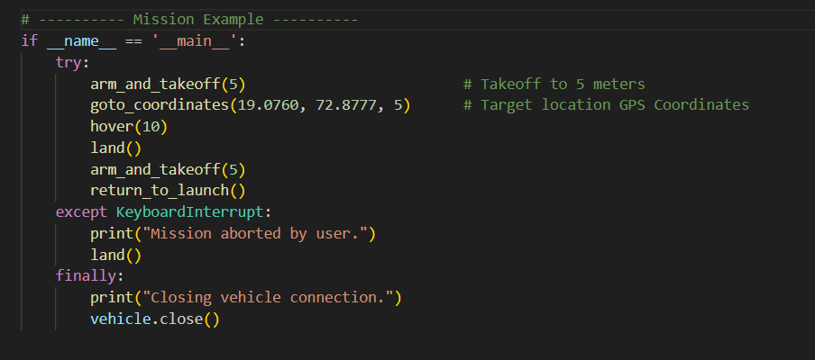
Example Script used while test flight :

Slide 8

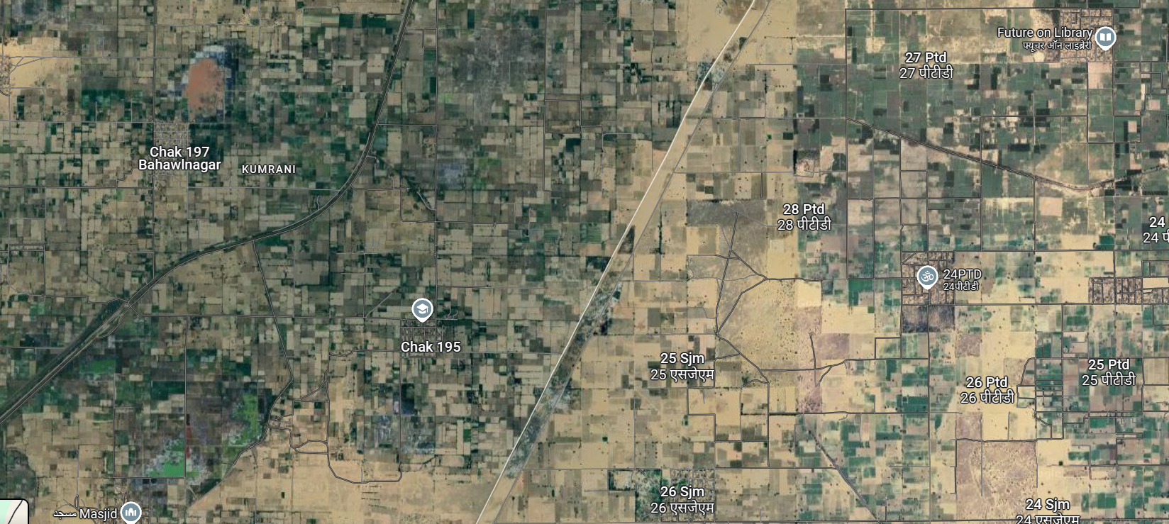
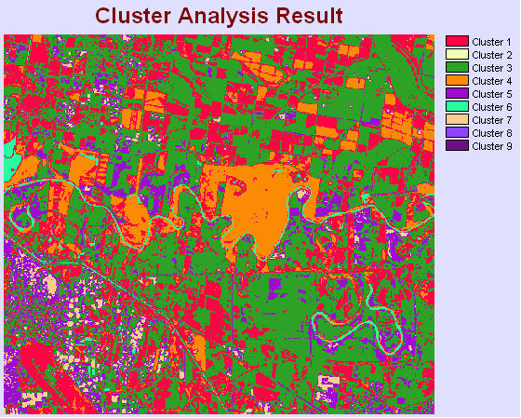
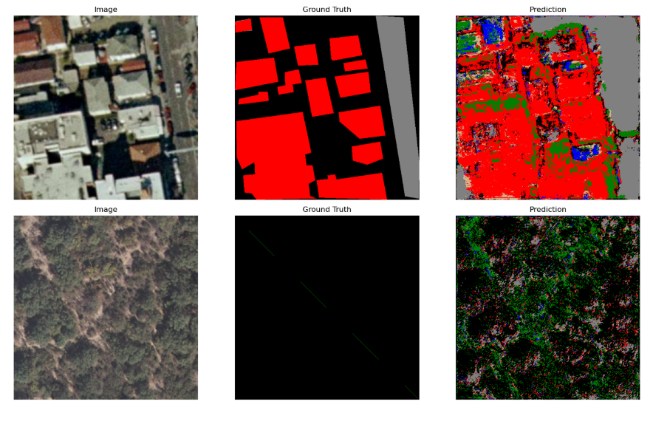
7) Making AI model for Path planning and coordinate generation of Path.
Step 1: Training AI model “efficientnet-b0” which is pretrained on "imagenet"
which has 6 classes(Forest, Road, River, Land, Buildings, Background). Library used pytorch for train model and labelme for annotation.
Satellite Image
Segmented Image

Slide 9
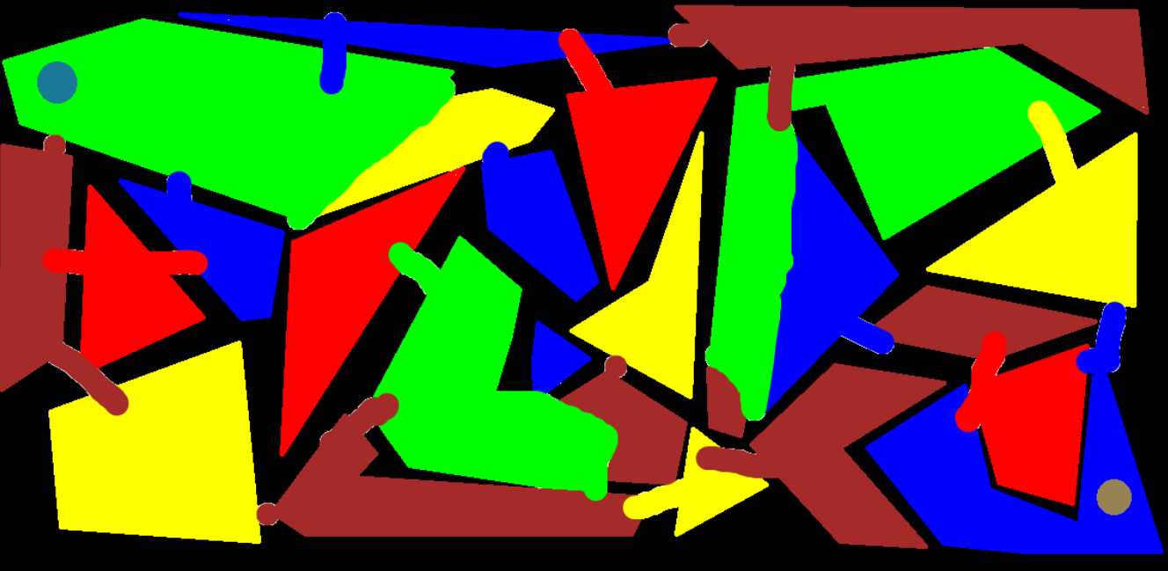
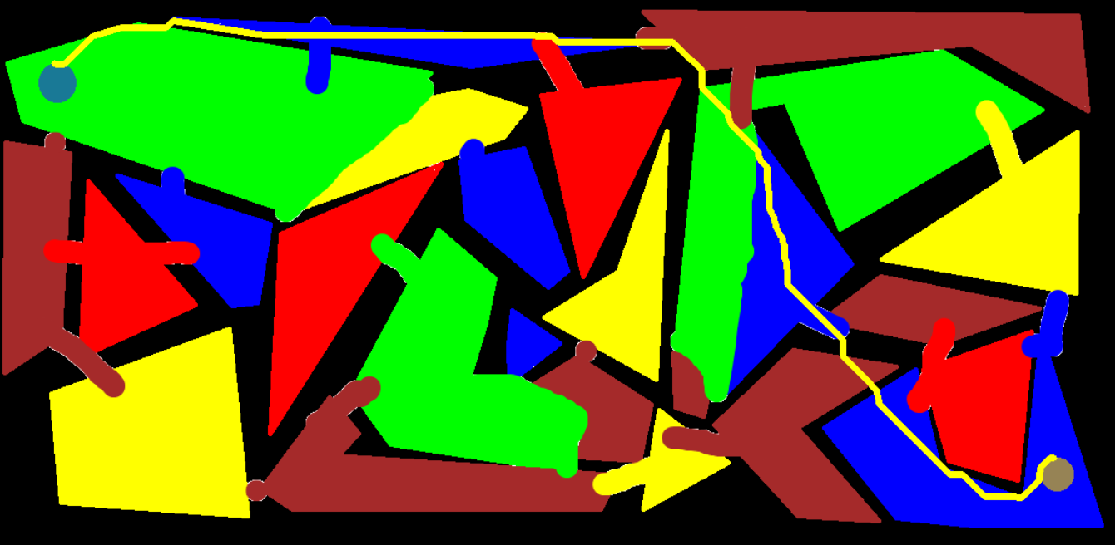
Step 2 : Using CV2 make a Script which performs a path planning program based on A* algorithm which is based on weights and converting into output txt file to feed it in drone.
Input Image
Output Image
'green’ : {'color': [0, 255, 0], 'weight': 3}, # Forest
'red’ : {'color': [0, 0, 255], 'weight': 5}, # Buildings
'yellow': {'color': [0, 255, 255], 'weight': 7}, # Road
'blue’ : {'color': [255, 0, 0], 'weight': 2}, # River
'brown’ : {'color': [42, 42, 165], 'weight': 4}, # Land
'black’ : {'color': [0, 0, 0], 'weight': 7} # Rest

Slide 10
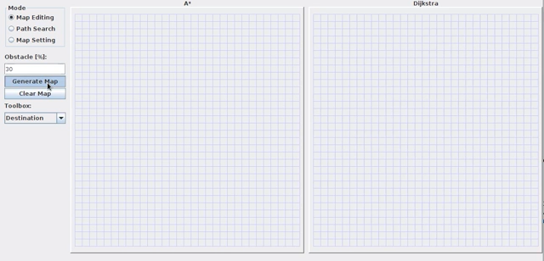
A* Algorithm Visualization :

Slide 11
Step 1) Understanding what GPS is required in pixhawk by drone.
Ans :
Latitude
Longitude
Altitude (AMSL) – altitude above mean sea level
Ground Speed (2D speed over the earth's surface)
3D Velocity Vector (North, East, Down components)
Direction in degrees of motion over the ground.
Number of satellites in use (satellites_used)
Total number of satellites visible (satellites_visible)
HDOP: Horizontal Dilution of Precision
VDOP: Vertical DOP
PDOP: Position DOP
GPS Time (UTC): high-accuracy universal time.

Slide 12
Step 2) Understanding Components to replace GPS and why.
Ans :
Latitude - Stereo Camera Calculations
Longitude - Stereo Camera Calculations
Altitude (AMSL) – altitude above mean sea level - Lidar or Stereo Camera + Calculations
Ground Speed (2D speed over the earth's surface) - Stereo Camera and IMU Sensor + Calculations
3D Velocity Vector (North, East, Down components) - Initially Given then calculated with IMU sensor
Direction in degrees of motion over the ground. - Calculated with IMU sensor readings
Number of satellites in use (satellites_used) - Fake Data Publishing
Total number of satellites visible (satellites_visible) - Fake Data Publishing
HDOP: Horizontal Dilution of Precision - Fake Data Publishing
VDOP: Vertical DOP - Fake Data Publishing
PDOP: Position DOP - Fake Data Publishing
GPS Time (UTC): high-accuracy universal time. - Given by flight Controller

